Slide 2
Goals
Reduce digital footprint by changing privacy settings
Instagram
Facebook
Ad-tracking
Start using a password manager
Bitwarden
Setup cloud backup

Slide 3
Goal 1: Reduce digital footprint by changing privacy settings

Slide 4

What data is collected?
Lets use Facebook as an example…

Slide 6
Data Collection
Action and behavior – likes, comments, scrolling, clicks, uploads, page visits
Dynamic
Profile information – information you provide Facebook when creating an account
Static
Digital footprint – information harvested from your phone and laptop
Dynamic
Cookies – collected from any website that uses Facebook services (e.g. ads)
Phone permissions
Other Facebook companies (Instagram, WhatsApp, Oculus etc.)
Facebook partners (e.g. loyalty cards)

Slide 7
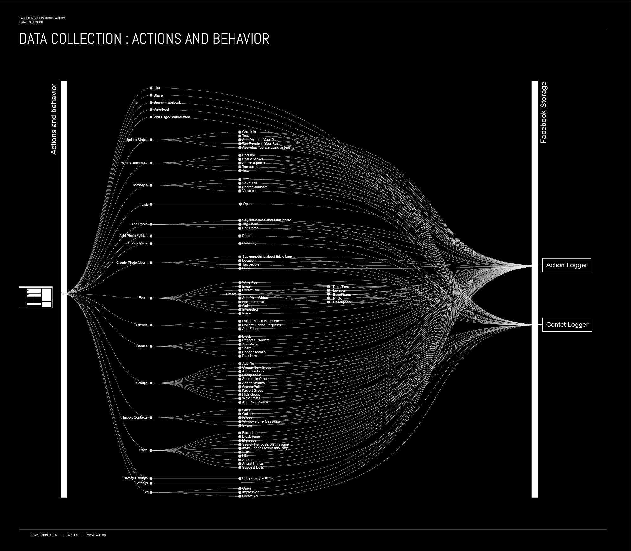

Slide 8
Goal 1: Reduce digital footprint by changing privacy settings
Spend 10 to 20 minutes going through the “Platform Tracking” portion of the shared Markdown file:
https://github.com/davidfastovich/willlab_privacy/blob/main/lab_privacy.md#platform-tracking
Try to complete as many of “Very Easy” steps as possible

Slide 9
Goal 2: Start using a password manager
We all reuse passwords…

Slide 10
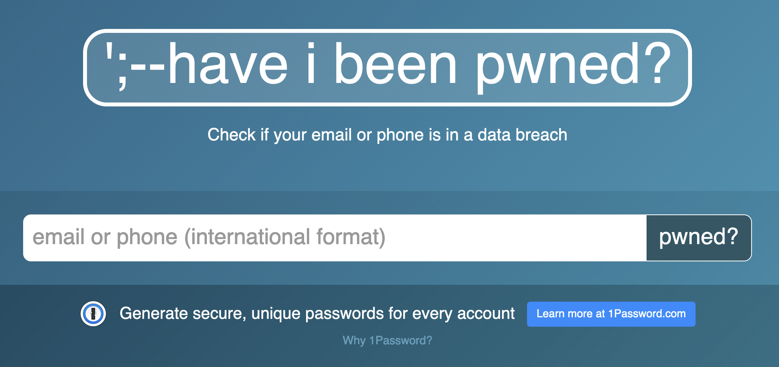
But have our passwords been leaked?

Slide 11
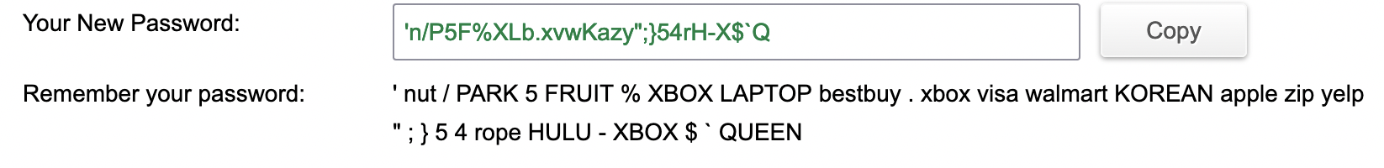
Random, complex passwords are best
But how do you remember this…? You don’t! Have a computer remember it.

Slide 12
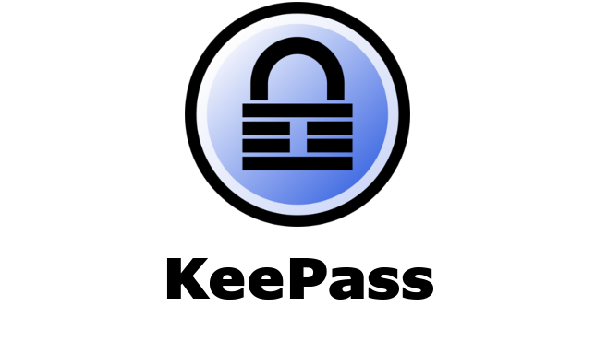

Password managers: online and offline
Bitwarden will store your passwords on their servers and provide an easy-to-use computer and mobile interface
With KeePass you control your passwords and who sees them from start to finish

Slide 13
Goal 2: Start using Bitwarden
Spend 20 to 30 minutes setting up Bitwarden Password Manager on your laptop and phone:
https://github.com/davidfastovich/willlab_privacy/blob/main/lab_privacy.md - password-managers
After you complete the steps outline you can start using random passwords and stop worrying about memorizing!

Slide 14
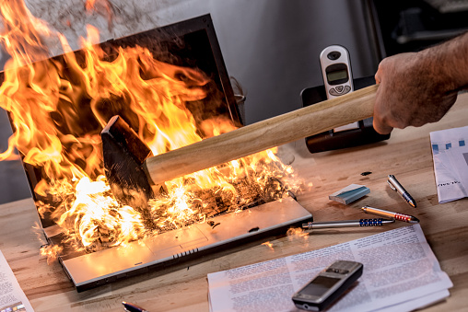
Goal 3: Setup cloud backup
Accidents happen, which is why backing up your data is so important

Slide 15
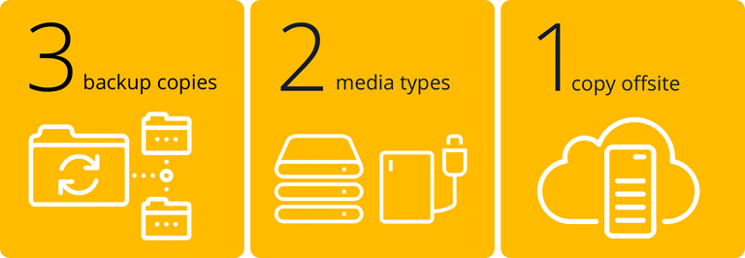
Local vs. online backups
Local backups – on media that is local to your computer (flash drive, hard drive, floppy disk)
Online backup – data backup up to servers managed by third parties (Google, Box, DropBox, Microsoft)

Slide 16
Goal 3: Setup cloud backup
1. Spend 20 to 30 minutes installing and setting up Google Drive or OneDrive or WiscBox
https://github.com/davidfastovich/willlab_privacy/blob/main/lab_privacy.md - how-to-backup-your-data
2. Move ALL of your important data within the folders created by these programs
3. Profit!

